Slide 1

WEKA in the Ecosystem for Scientific Computing

Slide 2
Contents
Part 1: Introduction to WEKA
Part 2: WEKA & Octave
Part 3: WEKA & R
Part 4: WEKA & Python
Part 5: WEKA & Hadoop
For this presentation, we used Ubuntu 13.10 with weka-3-7-11.zip extracted in the user's home folder.
All commands were executed from the home folder.
© THE UNIVERSITY OF WAIKATO • TE WHARE WANANGA O WAIKATO

Slide 3
Part 1:
Introduction to WEKA

Slide 4
What’s WEKA?
WEKA is a library containing a large collection of machine learning algorithms, implemented in Java
Main types of learning problems that it can tackle:
  Classification: given a labelled set of observations, learn to predict labels for new observations
  Regression: numeric value instead of label
  Attribute selection: find attributes of observations that are important for prediction
  Clustering: no labels, just identify groups of similar observations (clusters)
There is also some support for association rule mining and (conditional) density estimation
© THE UNIVERSITY OF WAIKATO • TE WHARE WANANGA O WAIKATO

Slide 5
How to use it via built-in options?
WEKA has three built-in graphical user interfaces:
  Explorer: still the most popular interface for batch data processing; tab-based interface to algorithms
  Knowledge Flow: users lay out and connect widgets representing WEKA components
  Experimenter: enables large scale comparison of predictive performance of learning algorithms
WEKA also has a command-line interface and its functionality can be accessed through the OS shell
Only Knowledge Flow and command-line interface enable incremental processing of data
© THE UNIVERSITY OF WAIKATO • TE WHARE WANANGA O WAIKATO

Slide 6
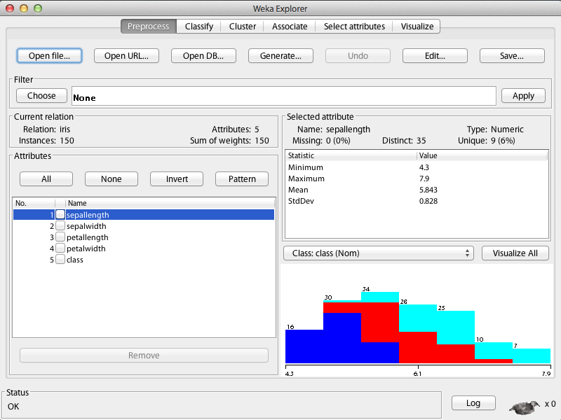
Explorer
© THE UNIVERSITY OF WAIKATO • TE WHARE WANANGA O WAIKATO

Slide 7
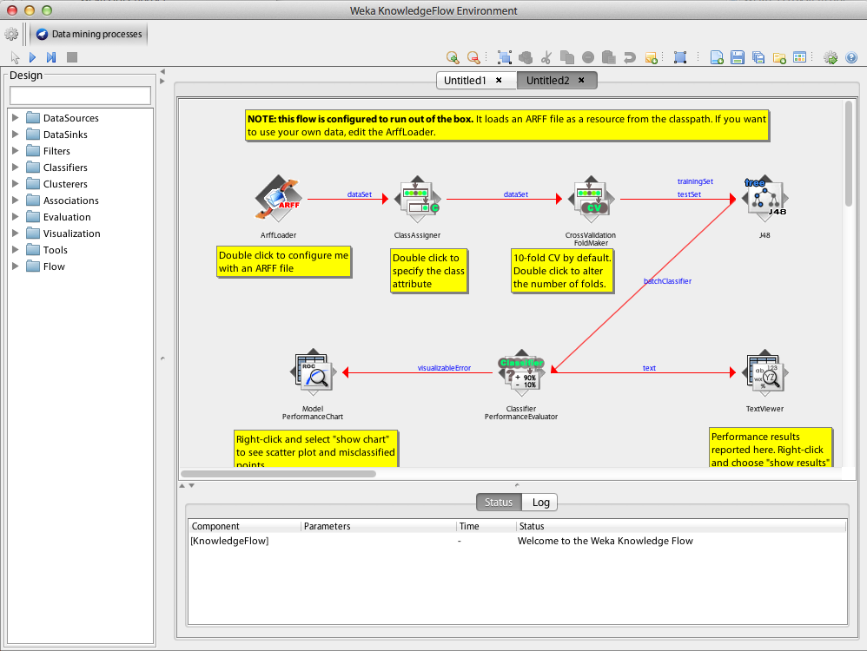
Knowledge Flow
© THE UNIVERSITY OF WAIKATO • TE WHARE WANANGA O WAIKATO

Slide 8
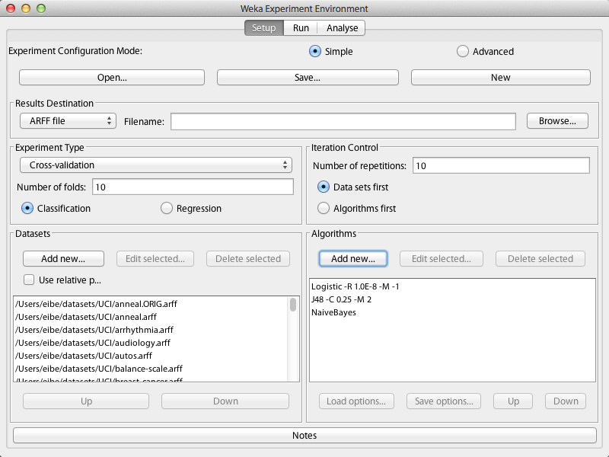
Experimenter
© THE UNIVERSITY OF WAIKATO • TE WHARE WANANGA O WAIKATO

Slide 9
How to use it via external interfaces?
WEKA provides a unified interface to a large collection of learning algorithms and is implemented in Java
There is a variety of software through which one can make use of this interface
  Octave/Matlab
  R statistical computing environment: RWeka
  Python: python-weka-wrapper
Other software through which one can access WEKA: Mathematica, SAS, KNIME, RapidMiner
© THE UNIVERSITY OF WAIKATO • TE WHARE WANANGA O WAIKATO

Slide 10
Part 2:
WEKA & Octave

Slide 11
Octave
GNU Octave is an open-source version of Matlab
(https://www.gnu.org/software/octave/)
Provides access to Java code through its Java package (http://wiki.octave.org/Java_package)
Installation on Ubuntu Linux:
  sudo apt-get install octave
  sudo apt-get install octave-java
In Octave, add WEKA to the Java CLASSPATH:
  javaaddpath("weka-3-7-11/weka.jar")
Check CLASSPATH:
  javaclasspath()
© THE UNIVERSITY OF WAIKATO • TE WHARE WANANGA O WAIKATO

Slide 12
Loading a dataset and building a tree
Load and output a dataset in WEKA’s ARFF format by creating an ArffLoader object:
l = javaObject("weka.core.converters.ArffLoader")
﻿l.setFile(javaObject("java.io.File",
"weka-3-7-11/data/iris.arff"))
﻿d = l.getDataSet
d.toString
Build and output a J48 decision tree:
﻿c = javaObject("weka.classifiers.trees.J48")
d.setClassIndex(d.numAttributes - 1)
﻿﻿c.buildClassifier(d)
c.toString
© THE UNIVERSITY OF WAIKATO • TE WHARE WANANGA O WAIKATO

Slide 13
Evaluation and data saving
Evaluate how well tree will predict, using 10-fold stratified cross-validation to estimate classification error, etc.:
﻿e = javaObject("weka.classifiers.Evaluation", d)
﻿e.crossValidateModel(c, d, 10,
javaObject("java.util.Random", 1),
javaArray("java.lang.Object",0))
﻿e.toSummaryString
Save data in Matlab format, load it back, and plot it:
﻿﻿s = javaObject("weka.core.converters.MatlabSaver")
﻿s.setFile(javaObject("java.io.File", "iris.data"))
﻿s.setInstances(d)
﻿s.writeBatch
﻿m = load("iris.data")
﻿scatter(m(:, 3), m(:, 4), 20, m(:, 5))
© THE UNIVERSITY OF WAIKATO • TE WHARE WANANGA O WAIKATO

Slide 14
Filtering and data conversion
Build classifier from reduced dataset:
﻿f = javaObject("weka.filters.unsupervised.
attribute.Remove")
﻿f.setAttributeIndices("1-2")
﻿f.setInputFormat(d)
﻿rD = javaMethod("useFilter",
"weka.filters.Filter", d, f)
c.buildClassifier(rD)
c.toString
Turn reduced data into Matlab matrix:
﻿rM = zeros(rD.numInstances, rD.numAttributes)
for i = 1:rD.numInstances
for j = 1:rD.numAttributes
﻿rM(i,j) = rD.instance(i - 1).value(j - 1)
end
end
© THE UNIVERSITY OF WAIKATO • TE WHARE WANANGA O WAIKATO

Slide 15
Storing and visualizing predictions
Store predictions for reduced dataset in a matrix:
﻿﻿p = zeros(rD.numInstances, rD.numClasses)
﻿for i = 1:rD.numInstances
dist = c.distributionForInstance(rD.instance(i - 1))
for j = 1:rD.numClasses
﻿ p(i,j) = dist(j)
end
end
Plot data using colors based on predicted probabilities:
﻿scatter(rM(:,1), rM(:,2), 20, p)
© THE UNIVERSITY OF WAIKATO • TE WHARE WANANGA O WAIKATO

Slide 16
Generating predictions for a grid of points
﻿﻿﻿[x, y] = meshgrid(1:.1:7, 0:.1:2.5)
﻿x = x(:)
y = y(:)
﻿﻿gM = [x y]
save grid.data gM -ascii
﻿﻿l = javaObject("weka.core.converters.MatlabLoader")
﻿l.setFile(javaObject("java.io.File","grid.data"))
gD = l.getDataSet
gD.insertAttributeAt(rD.attribute(2), 2)
﻿gD.setClassIndex(2)
﻿p = zeros(gD.numInstances, gD.numClasses)
﻿for i = 1:gD.numInstances
dist = c.distributionForInstance(gD.instance(i - 1))
for j = 1:gD.numClasses
﻿ p(i, j) = dist(j)
end
end
﻿scatter(gM(:,1), gM(:,2), 20, p)
© THE UNIVERSITY OF WAIKATO • TE WHARE WANANGA O WAIKATO

Slide 17
Clustering and visualizing data
f = javaObject("weka.filters.unsupervised.
attribute.Remove")
﻿f.setAttributeIndices("last")
f.setInputFormat(d)
﻿rD = javaMethod("useFilter","weka.filters.Filter", d, f)
﻿c = javaObject("weka.clusterers.SimpleKMeans")
﻿c.setNumClusters(3)
﻿c.buildClusterer(rD)
﻿c.toString
a = zeros(rD.numInstances, 1)
for i = 1:rD.numInstances
a(i) = c.clusterInstance(rD.instance(i - 1))
end
﻿scatter(m(:,3), m(:,4), 20, a)
© THE UNIVERSITY OF WAIKATO • TE WHARE WANANGA O WAIKATO

Slide 18
Finding the most important predictors
﻿﻿﻿as = javaObject("weka.attributeSelection.
AttributeSelection")
﻿﻿s = javaObject("weka.attributeSelection.GreedyStepwise")
﻿s.setSearchBackwards(true)
﻿as.setSearch(s)
﻿﻿e = javaObject("weka.attributeSelection.
WrapperSubsetEval")
﻿﻿﻿e.setClassifier(javaObject("weka.
classifiers.trees.J48"))﻿
﻿as.setEvaluator(e)
﻿as.SelectAttributes(d)
﻿as.toResultsString
© THE UNIVERSITY OF WAIKATO • TE WHARE WANANGA O WAIKATO

Slide 19
Build a classifier with attribute selection
﻿﻿﻿﻿Build a tree based on selected attributes:
﻿﻿﻿﻿c = javaObject("weka.classifiers.meta.
AttributeSelectedClassifier")
﻿c.setEvaluator(e)
﻿﻿c.setSearch(s)
﻿﻿c.setClassifier(javaObject("weka.
classifiers.trees.J48"))
﻿﻿﻿c.buildClassifier(d)
﻿﻿﻿﻿c.toString
Estimate performance of model with attribute selection:
﻿﻿﻿﻿e = javaObject("weka.classifiers.Evaluation", d)
﻿e.crossValidateModel(c, d, 10,
javaObject("java.util.Random", 1),
javaArray("java.lang.Object",0))
﻿e.toSummaryString﻿
© THE UNIVERSITY OF WAIKATO • TE WHARE WANANGA O WAIKATO

Slide 20
Using code from a WEKA package
WEKA 3.7 has a package management system through which a lot of additional packages are available
These packages are in separate Java .jar archives, not in the main weka.jar archive
Need to load all these packages into the Octave CLASSPATH, so that they can be used from Octave:
javaMethod("loadPackages",
"weka.core.WekaPackageManager", false, true, false)
Should check CLASSPATH afterwards:
javaclasspath()
© THE UNIVERSITY OF WAIKATO • TE WHARE WANANGA O WAIKATO

Slide 21
Part 3:
WEKA & R

Slide 22
R
Open-source R system for statistical computing implements the S language developed at Bell labs
(http://www.r-project.org/)
Provides access to Weka through RWeka package (http://cran.r-project.org/package=RWeka)
Installation on Ubuntu Linux (tried with Ubuntu 13.10):
  ﻿sudo apt-get install r-base
In R, install RWeka package (includes latest WEKA):
  ﻿install.packages("RWeka", dependencies = TRUE)
Once installed, start R, and load the package into R:
  ﻿library(RWeka)
© THE UNIVERSITY OF WAIKATO • TE WHARE WANANGA O WAIKATO

Slide 23
Using WEKA from R
Read ARFF file into R data frame and plot it:
  ﻿﻿d <- read.arff(file("weka-3-7-11/data/iris.arff"))
  ﻿plot(d, col=c("red","blue","green")[d$class])
Build and output decision tree using built-in J48 wrapper:
  ﻿﻿c <- J48(class ~., d)
  c
Install and use partykit package for tree visualization:
  ﻿install.packages("partykit", dependencies = TRUE)
  library(partykit)
  plot(c)
Run 10-fold cross-validation using tree learner:
  ﻿﻿evaluate_Weka_classifier(c, numFolds = 10)
© THE UNIVERSITY OF WAIKATO • TE WHARE WANANGA O WAIKATO

Slide 24
Accessing arbitrary classifiers and filters
Can access any classifier in WEKA:
﻿NB <- make_Weka_classifier("weka.classifiers.bayes.
NaiveBayes")
NB
﻿NB(class ~., d)
List scheme options and change them using control:
﻿WOW(NB)
﻿NB(class ~., d, control = Weka_control(D = TRUE))
A similar process works for filters:
﻿Remove <- make_Weka_filter("weka.filters.
unsupervised.attribute.Remove")
WOW(Remove)
rD <- Remove(~., d, control = Weka_control(R = "1,2"))
rD
© THE UNIVERSITY OF WAIKATO • TE WHARE WANANGA O WAIKATO

Slide 25
Storing and visualizing predictions
Obtain predicted class probabilities and plot them:
﻿﻿﻿﻿﻿﻿c <- J48(class ~., rD)
p <- predict(c, rD, c("probability"))
﻿﻿plot(rD[1:2], col = rgb(p))
Generate grid and plot predicted probabilities:
﻿gD <- expand.grid(petallength = seq(1, 7, 0.1),
petalwidth = seq(0, 2.5, 0.1), class =
c("Iris-setosa","Iris-versicolor", "Iris-virginica"))
﻿p <- predict(c, gD, c("probability"))
﻿plot(gD[1:2], col = rgb(p))
© THE UNIVERSITY OF WAIKATO • TE WHARE WANANGA O WAIKATO

Slide 26
Clustering data
﻿﻿﻿﻿Build clustering model:
﻿﻿﻿rD <- Remove(~., d, control = Weka_control(R = "last"))
﻿c <- SimpleKMeans(rD, control = Weka_control(N = 3))
c
﻿﻿﻿﻿Visualize cluster assignments:
﻿﻿﻿﻿p <- predict(c, rD, c("membership"))
﻿plot(rD[3:4], col = rgb(p))
﻿
© THE UNIVERSITY OF WAIKATO • TE WHARE WANANGA O WAIKATO

Slide 27
Attribute selection
﻿﻿﻿﻿Rank the predictors:
﻿﻿﻿﻿﻿﻿﻿InfoGainAttributeEval(class ~., d)
  Attribute subset selection can be applied as part of learning a classifier:
  ﻿AttributeSelectedClassifier = make_Weka_classifier("weka.
  classifiers.meta.AttributeSelectedClassifier")
  ﻿﻿﻿﻿﻿﻿﻿c = AttributeSelectedClassifier(class ~., d,
  control = Weka_control(W = ".J48",
  E = ".WrapperSubsetEval -B .J48",
  S = ".GreedyStepwise -B"))
  ﻿﻿evaluate_Weka_classifier(c, numFolds = 10)
  We can also make a filter for attribute subset selection using weka.filters.supervised.attribute.AttributeSelection
© THE UNIVERSITY OF WAIKATO • TE WHARE WANANGA O WAIKATO

Slide 28
Text classification and performance plots
﻿﻿FilteredClassifier = make_Weka_classifier("weka.classifiers.
meta.FilteredClassifier")
d <- read.arff("weka-3-7-11/data/ReutersCorn-train.arff")
﻿fc <- FilteredClassifier(`class-att` ~., d,
control = Weka_control(F = ".StringToWordVector",
W = ".NaiveBayesMultinomial"))
﻿td <- read.arff("weka-3-7-11/data/ReutersCorn-test.arff")
﻿p = predict(fc, td, "probability")[,"1"]
﻿﻿labels = td["class-att"]
﻿install.packages("ROCR")
library(ROCR)
﻿pred <- prediction(p, labels)
﻿perf <- performance(pred, "tpr", "fpr")
﻿plot(perf)
perf <- performance(pred, "sens", "spec")
plot(perf)
﻿perf <- performance(pred, "cal")
plot(perf)
© THE UNIVERSITY OF WAIKATO • TE WHARE WANANGA O WAIKATO

Slide 29
WPM command for package management
Refresh cache of WEKA packages:
WPM("refresh-cache")
List packages:
WPM("list-packages", "installed")
WPM("list-packages", "available")
Print package info:
WPM("package-info", "repository", "XMeans")
Install and load package:
WPM("install-package", "XMeans")
WPM("load-package", "XMeans")
© THE UNIVERSITY OF WAIKATO • TE WHARE WANANGA O WAIKATO

Slide 30
Using R from WEKA
  RPlugin package for WEKA 3.7 provides:
  (http://weka.sourceforge.net/packageMetaData/RPlugin/index.html)
  java weka.core.WekaPackageManager -install-package RPlugin
  A Knowledge Flow component to execute R scripts
  A "wrapper" classifier for all MLR algorithms
  An R console for the Explorer and Knowledge Flow
Requires environment variable R_HOME to be set to the value returned by issuing the following command in R:
﻿R.home(component = "home")
Set R_LIBS_USER to first value returned by: .libPaths()
rJava package needs to be installed in R:
﻿install.packages("rJava")
© THE UNIVERSITY OF WAIKATO • TE WHARE WANANGA O WAIKATO

Slide 31
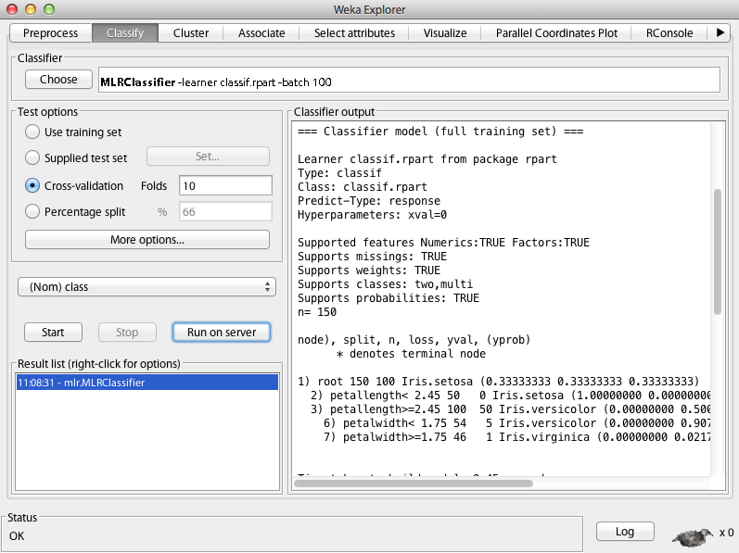
Applying an MLR classifier
© THE UNIVERSITY OF WAIKATO • TE WHARE WANANGA O WAIKATO

Slide 32
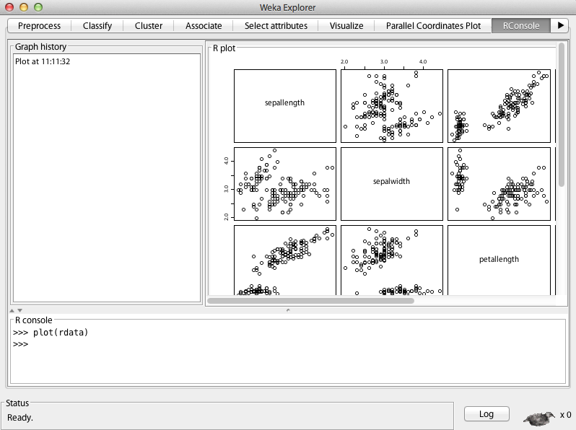
Visualizing data using the R console
© THE UNIVERSITY OF WAIKATO • TE WHARE WANANGA O WAIKATO

Slide 33
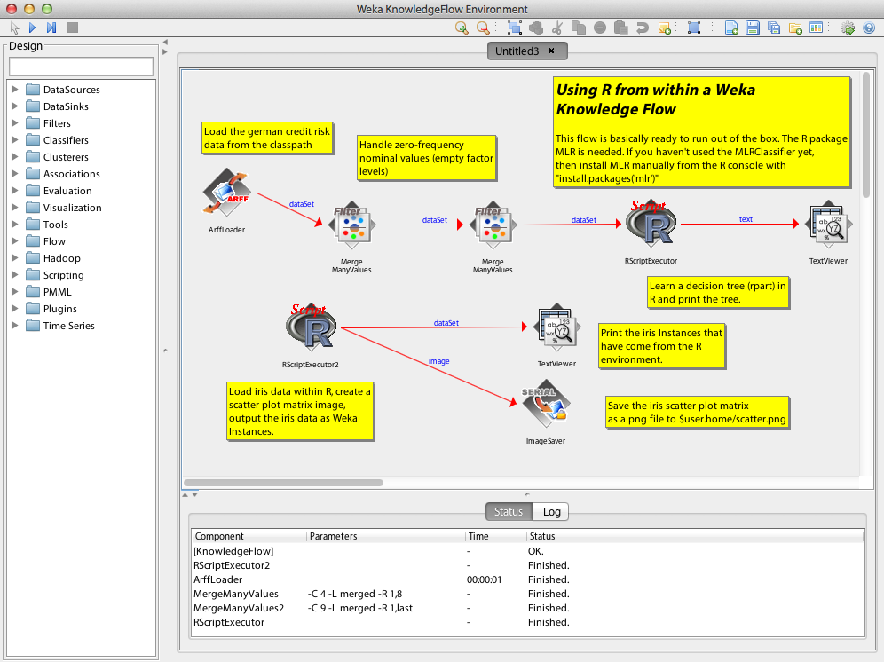
Processing data using an R component
© THE UNIVERSITY OF WAIKATO • TE WHARE WANANGA O WAIKATO

Slide 34
Part 4:
WEKA & Python

Slide 35
Python and WEKA
WEKA can be used directly from Jython, a Python implementation for the Java Virtual Machine
However, several important libraries for Python are implemented in native code and not available in Jython
Fortunately, there is a nice way to run WEKA from Python: http://pythonhosted.org//python-weka-wrapper/
First, install dev tools, pip and packages for Python:
﻿sudo apt-get install python-pip python-numpy
python-dev ﻿python-imaging python-matplotlib
python-pygraphviz ﻿imagemagick
Then, install javabridge and weka wrapper for Python:
sudo pip install javabridge ﻿python-weka-wrapper
© THE UNIVERSITY OF WAIKATO • TE WHARE WANANGA O WAIKATO

Slide 36
Using WEKA from Python
First, need to start the JVM from Python:
import weka.core.jvm as jvm
jvm.start()
﻿We can get help on the commands:
help(jvm.start)
Load and print some data in ARFF format:
from weka.core.converters import Loader
l = Loader("weka.core.converters.ArffLoader")
d = l.load_file("weka-3-7-11/data/iris.arff")
d.set_class_index(d.num_attributes() - 1)
print(d)
© THE UNIVERSITY OF WAIKATO • TE WHARE WANANGA O WAIKATO

Slide 37
Building and evaluating a classifier
Build and print a decision tree:
from weka.classifiers import Classifier
c = Classifier("weka.classifiers.trees.J48")
c.build_classifier(d)
print(c)
﻿Evaluate classifier using cross-validation:
from weka.classifiers import Evaluation
from weka.core.classes import Random
e = Evaluation(d)
e.crossvalidate_model(c, d, 10, Random(1))
print(e.percent_correct())
print(e.to_summary())
print(e.to_class_details())
© THE UNIVERSITY OF WAIKATO • TE WHARE WANANGA O WAIKATO

Slide 38
Visualize classifier based on filtered data
from weka.filters import Filter
r =Filter("weka.filters.unsupervised.attribute.Remove",
options = ["-R", "1, 2"])
r.set_inputformat(d)
rD = r.filter(d)
c.build_classifier(rD)
import weka.plot.graph as graph
graph.plot_dot_graph(c.graph())
import weka.plot.dataset as pld
pld.scatter_plot(rD, 0, 1, percent=100)
© THE UNIVERSITY OF WAIKATO • TE WHARE WANANGA O WAIKATO

Slide 39
Visualize class probabilities
r = range(0, rD.num_instances())
﻿x = [rD.get_instance(i).get_value(0) for i in r]
﻿y = [rD.get_instance(i).get_value(1) for i in r]
﻿p = [c.distribution_for_instance(rD.get_instance(i))
for i in r]
﻿import matplotlib.pyplot as plot
﻿plot.scatter(x, y, 20, p)
plot.show()
© THE UNIVERSITY OF WAIKATO • TE WHARE WANANGA O WAIKATO

Slide 40
Plot grid of predictions
﻿s0 = rD.get_attribute_stats(0).numeric_stats()﻿
s1 = rD.get_attribute_stats(1).numeric_stats()﻿
r = range(0,101)
﻿x = [s0.min()+(s0.max()-s0.min())*i/100 for i in r]
y = [s1.min()+(s1.max()-s1.min())*i/100 for i in r]﻿
﻿gD = d.template_instances(rD)
﻿from weka.core.dataset import Instance
﻿for i in range(len(x)):
for j in range(len(y)):
﻿ gD.add_instance(Instance.
create_instance([x[i], y[j], 0]))
r = range(0, gD.num_instances())
x = [gD.get_instance(i).get_value(0) for i in r]
﻿y = [gD.get_instance(i).get_value(1) for i in r]
p = [c.distribution_for_instance(gD.get_instance(i))
for i in r]
﻿import matplotlib.pyplot as plot
﻿plot.scatter(x, y, 20, p)
plot.show()
© THE UNIVERSITY OF WAIKATO • TE WHARE WANANGA O WAIKATO

Slide 41
Cluster data and visualize clusters
﻿r =Filter("weka.filters.unsupervised.attribute.Remove",
options = ["-R", "last"])
r.set_inputformat(rD)
rD = r.filter(rD)
from weka.clusterers import Clusterer﻿
clu = Clusterer("weka.clusterers.SimpleKMeans",
options = ["-N", "3"])
clu.build_clusterer(rD)
print(clu)
r = range(0, rD.num_instances())
﻿x = [rD.get_instance(i).get_value(0) for i in r]
﻿y = [rD.get_instance(i).get_value(1) for i in r]
﻿p = [clu.distribution_for_instance(rD.get_instance(i))
for i in r]
﻿import matplotlib.pyplot as plot
﻿plot.scatter(x, y, 20, p)
plot.show()
© THE UNIVERSITY OF WAIKATO • TE WHARE WANANGA O WAIKATO

Slide 42
Attribute selection
﻿﻿﻿from weka.attribute_selection import
ASSearch, ASEvaluation, AttributeSelection
s = ASSearch("weka.attributeSelection.GreedyStepwise",
options = ["-B"])
e = ASEvaluation("weka.attributeSelection.
WrapperSubsetEval",
options=["-B", ".J48"])
attS = AttributeSelection()
attS.set_search(s)
attS.set_evaluator(e)
attS.select_attributes(d)
print(attS.to_results_string())
© THE UNIVERSITY OF WAIKATO • TE WHARE WANANGA O WAIKATO

Slide 43
Build a classifier with attribute selection
﻿﻿﻿﻿Build a tree based on selected attributes:
﻿﻿﻿﻿﻿c = Classifier("weka.classifiers.meta.
AttributeSelectedClassifier",
options = ["-S", ".GreedyStepwise -B", "-E",
".WrapperSubsetEval -B .J48"])﻿﻿
c.build_classifier(d)
print(c)
Estimate performance of model with attribute selection:
﻿﻿﻿﻿from weka.classifiers import Evaluation
from weka.core.classes import Random
e = Evaluation(d)
e.crossvalidate_model(c, d, 10, Random(1))
print(e.to_summary())
© THE UNIVERSITY OF WAIKATO • TE WHARE WANANGA O WAIKATO

Slide 44
Managing WEKA packages from Python
import weka.core.packages as packages
items = packages.get_all_packages()
for item in items:
if item.get_name() == "CLOPE":
print item.get_name(), item.get_url()
packages.install_package("CLOPE")
items = packages.get_installed_packages()
for item in items:
print item.get_name(), item.get_url()
﻿from weka.clusterers import Clusterer
﻿clu = Clusterer("weka.clusterers.CLOPE")
﻿clu.build_clusterer(rD)
print(clu)
packages.uninstall_package("CLOPE")
items = packages.get_installed_packages()
for item in items:
print item.get_name(), item.get_url()
© THE UNIVERSITY OF WAIKATO • TE WHARE WANANGA O WAIKATO

Slide 45
Part 5:
WEKA & Hadoop

Slide 46
Apache Hadoop
﻿﻿﻿﻿Java system for distributed storage (HDFS) and computation (MapReduce)
Useful for storing and processing large datasets that are too large for a single computer
WEKA 3.7 now has some support for using Hadoop, based on two packages:
  The distributedWekaBase package has basic infrastructure for distributed computation
  The distributedWekaHadoop package provides an implementation for Hadoop
In the following, we will install and use Hadoop on a single computer for simplicity
© THE UNIVERSITY OF WAIKATO • TE WHARE WANANGA O WAIKATO

Slide 47
Setting things up
Download and install Hadoop package:
﻿wget https://archive.apache.org/dist/hadoop/core/hadoop-1.2.1/hadoop-1.2.1-bin.tar.gz
﻿tar -xzf hadoop-1.2.1-bin.tar.gz
Need to modify the following configuration files in ﻿hadoop-1.2.1/conf/:
  core-site.xml
  hdfs-site.xml
  mapred-site.xml
  hadoop-env.sh
© THE UNIVERSITY OF WAIKATO • TE WHARE WANANGA O WAIKATO

Slide 48
core-site.xml
<?xml version="1.0"?>
<?xml-stylesheet type="text/xsl" href="configuration.xsl"?>
<configuration>
<property>
<name>fs.default.name</name>
<value>hdfs://localhost:8020</value>
</property>
<property>
<name>hadoop.tmp.dir</name>
<value>/home/eibe/hadoop/tmp</value>
</property>
<property>
<name>dfs.data.dir</name>
<value>/home/eibe/hadoop/data</value>
</property>
</configuration>
© THE UNIVERSITY OF WAIKATO • TE WHARE WANANGA O WAIKATO

Slide 49
hdfs-site.xml
﻿<?xml version="1.0"?>
<?xml-stylesheet type="text/xsl" href="configuration.xsl"?>
<configuration>
<property>
<name>dfs.replication</name>
<value>1</value>
</property>
<property>
<name>dfs.permissions</name>
<value>false</value>
</property>
</configuration>
© THE UNIVERSITY OF WAIKATO • TE WHARE WANANGA O WAIKATO

Slide 50
mapred-site.xml
﻿<?xml version="1.0"?>
<?xml-stylesheet type="text/xsl" href="configuration.xsl"?>
<configuration>
<property>
<name>mapred.job.tracker</name>
<value>localhost:8021</value>
</property>
</configuration>
© THE UNIVERSITY OF WAIKATO • TE WHARE WANANGA O WAIKATO

Slide 51
Starting Hadoop
Set the location of JAVA_HOME in hadoop-env.sh:
﻿﻿export JAVA_HOME=$(readlink -f /usr/bin/javac |
sed "s:/bin/javac::")
Install Open SSH and enable password-less login:
sudo apt-get install openssh-client openssh-server
ssh-keygen -t rsa -P '' -f ~/.ssh/id_rsa
cat ~/.ssh/id_rsa.pub >> ~/.ssh/authorized_keys
Format the Hadoop file system:
﻿﻿hadoop-1.2.1/bin/hadoop namenode -format
Start Hadoop:
﻿﻿hadoop-1.2.1/bin/start-all.sh
© THE UNIVERSITY OF WAIKATO • TE WHARE WANANGA O WAIKATO

Slide 52
Setting up WEKA and transferring data
Set the Java CLASSPATH to point to WEKA:
﻿﻿export CLASSPATH=/home/eibe/weka-3-7-11/weka.jar
Install the necessary WEKA packages:
java weka.core.WekaPackageManager
-install-package distributedWekaHadoop
Save some data in CSV format in HDFS:
java weka.Run .HDFSSaver -i ~/weka-3-7-11/data/iris.arff
-dest /users/eibe/input/classification/iris.csv
-saver "weka.core.converters.CSVSaver -N"
Check that the data is in fact in HDFS:
﻿﻿﻿hadoop-1.2.1/bin/hadoop fs
-cat /users/eibe/input/classification/iris.csv
© THE UNIVERSITY OF WAIKATO • TE WHARE WANANGA O WAIKATO

Slide 53
Running some WEKA jobs
Create an ARFF file with summary information in HDFS:
﻿﻿﻿﻿java weka.Run .ArffHeaderHadoopJob
-input-paths /users/eibe/input/classification
-output-path /users/eibe/output
-A sepallength,sepalwidth,petallength,petalwidth,class
-header-file-name iris.header.arff
Can check on jobs by browsing to: http://localhost:50030
Check the header file:
﻿hadoop-1.2.1/bin/hadoop fs
-cat /users/eibe/output/arff/iris.header.arff
Compute correlation matrix:
﻿java weka.Run .CorrelationMatrixHadoopJob
-existing-header /users/eibe/output/arff/iris.header.arff
-class last -input-paths /users/eibe/input/classification
-output-path /users/eibe/output
© THE UNIVERSITY OF WAIKATO • TE WHARE WANANGA O WAIKATO

Slide 54
Building and evaluating classifiers
Build an ensemble of J48 trees (using "dagging"):
﻿﻿﻿﻿﻿java weka.Run .WekaClassifierHadoopJob
-existing-header /users/eibe/output/arff/iris.header.arff
-class last -input-paths /users/eibe/input/classification
-output-path /users/eibe/output
-W weka.classifiers.trees.J48
-model-file-name J48_dist.model
-randomized-chunks -num-chunks 10
Evaluate the classifier using cross-validation in Hadoop:
﻿﻿java weka.Run .WekaClassifierEvaluationHadoopJob
-existing-header /users/eibe/output/arff/iris.header.arff
-class last -input-paths /users/eibe/input/classification
-output-path /users/eibe/output
-W weka.classifiers.trees.J48
-model-file-name J48_dist.model
-randomized-chunks -num-chunks 10 -num-folds 10
© THE UNIVERSITY OF WAIKATO • TE WHARE WANANGA O WAIKATO

Slide 55
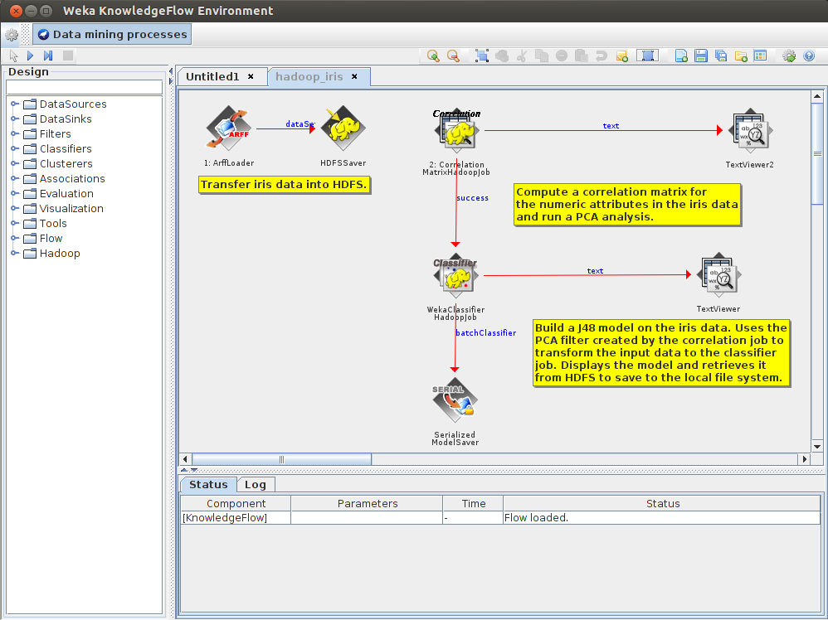
Using Hadoop via the Knowledge Flow GUI
http://www.cs.waikato.ac.nz/ml/weka/xml/examples/hadoop_iris.kfml
© THE UNIVERSITY OF WAIKATO • TE WHARE WANANGA O WAIKATO

